Slide 1
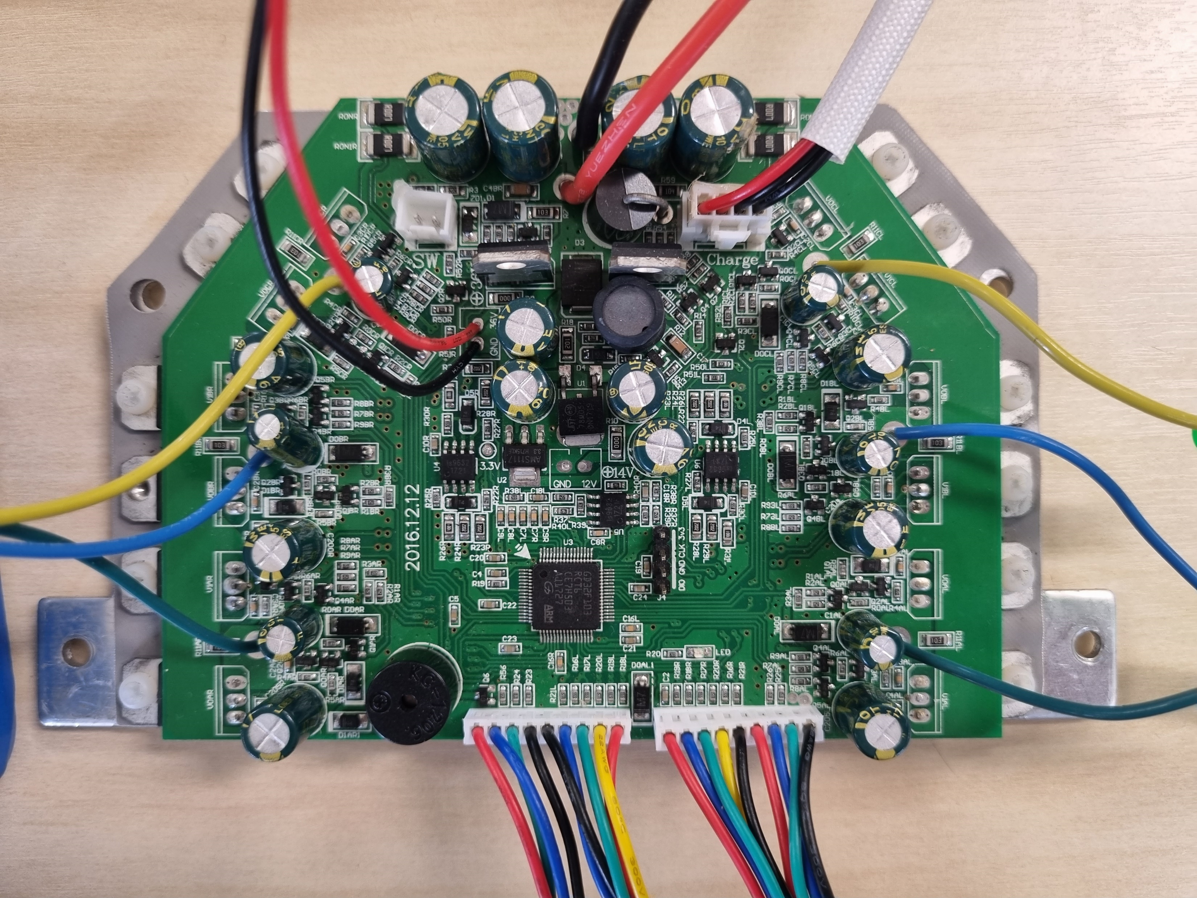

Slide 2
BATTERY (36VDC expected)
36VDC
5VDC
3.3VDC
14VDC

Slide 3
BATTERY
POWER SWITCH
CHARGER
36V OUT
BRUSHLESS MOTOR WIRES
SWD PROGRAMMING
SENSOR BOARD
HALL EFFECT WIRES
SENSOR BOARD

Slide 4
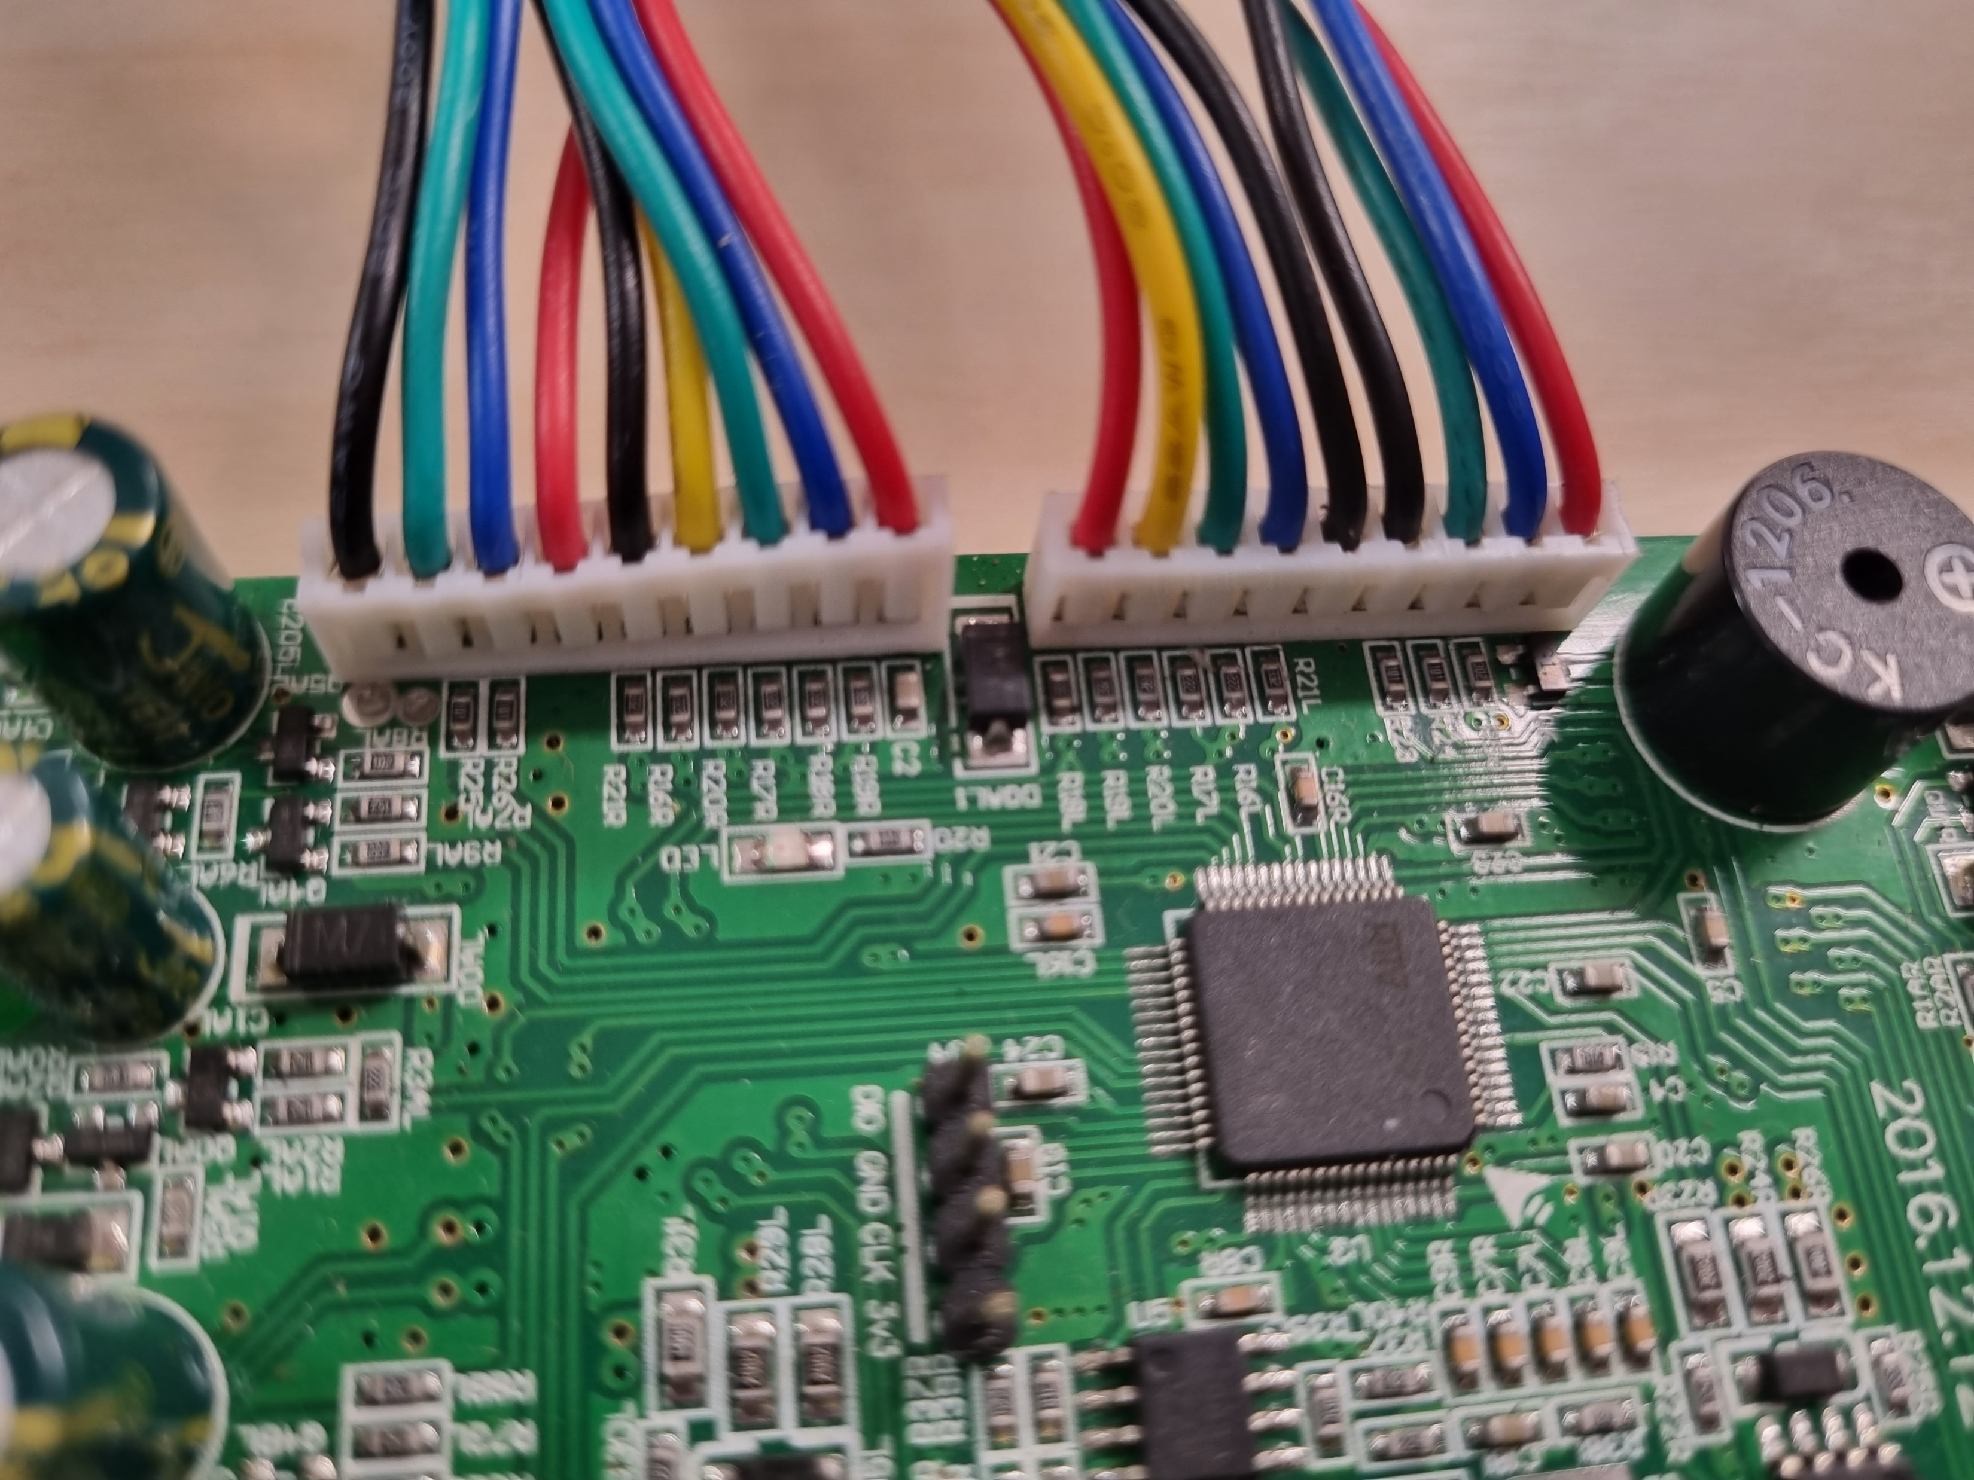
GND
15V
5V
5V
15V
GND
GND
HALL C
GND
HALL B
HALL A
HALL C
HALL B
HALL A
PB10 / TX / SCL
PA2 / TX / ADC1
PB11 / RX / SDA
PA3 / RX / ADC2 / PPM
PA13 / SWDIO
GND
PA14 / SWCLK
3.3V

